Slide 1
INTRODUCTION:
KitchenSync is a comprehensive platform designed to make meal planning and pantry management a simple part of your daily routine. It's not just another tool for organizing the kitchen. Whether you're a working professional with a hectic schedule or a parent balancing the obligations of family life, KitchenSync is here to make your kitchen experience more efficient.

Slide 2
Agenda
Introduction
Problem Statement
Project description
Team members and roles
Persona
Technologies and Languages used
Teamwork agreement
Schedule
Retrospective
Wiki Page

Slide 3
Problem Statement:
Managing food inventory is a bit like juggling. You need to keep everything in balance — ensuring there's enough stock to meet demand, but not so much that it goes to waste. It's a tough act, especially with perishables that have a ticking clock from the moment they're harvested or produced. Traditional systems often fall short, leading to overstocked kitchens and stores, unnecessary waste, and, worst of all, the risk of serving or selling food that's past its prime. Not to mention, without the right tools, predicting how much stock you need is more guesswork than science.

Slide 4
Project Description:
KitchenSync is designed for busy individuals, families, and small firms that struggle to keep their pantries organized and cut down on food waste. This trailblazing system offers improved pantry management and meal planning, suggests recipes with what you have, and notifies you about the shelf life of your food items. Unlike other traditional inventory systems and shopping list apps, KitchenSync adjusts to your dietary preferences and schedules by making use of readily available ingredients to simplify the meal preparation process.

Slide 5
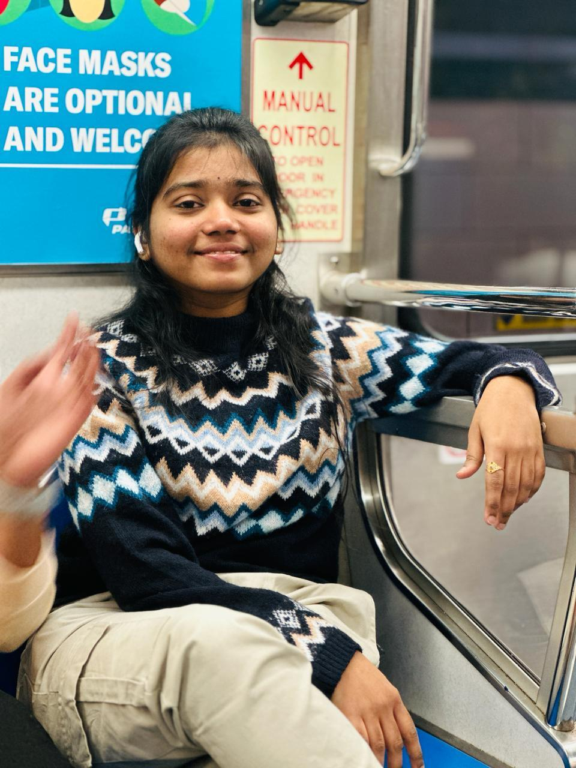

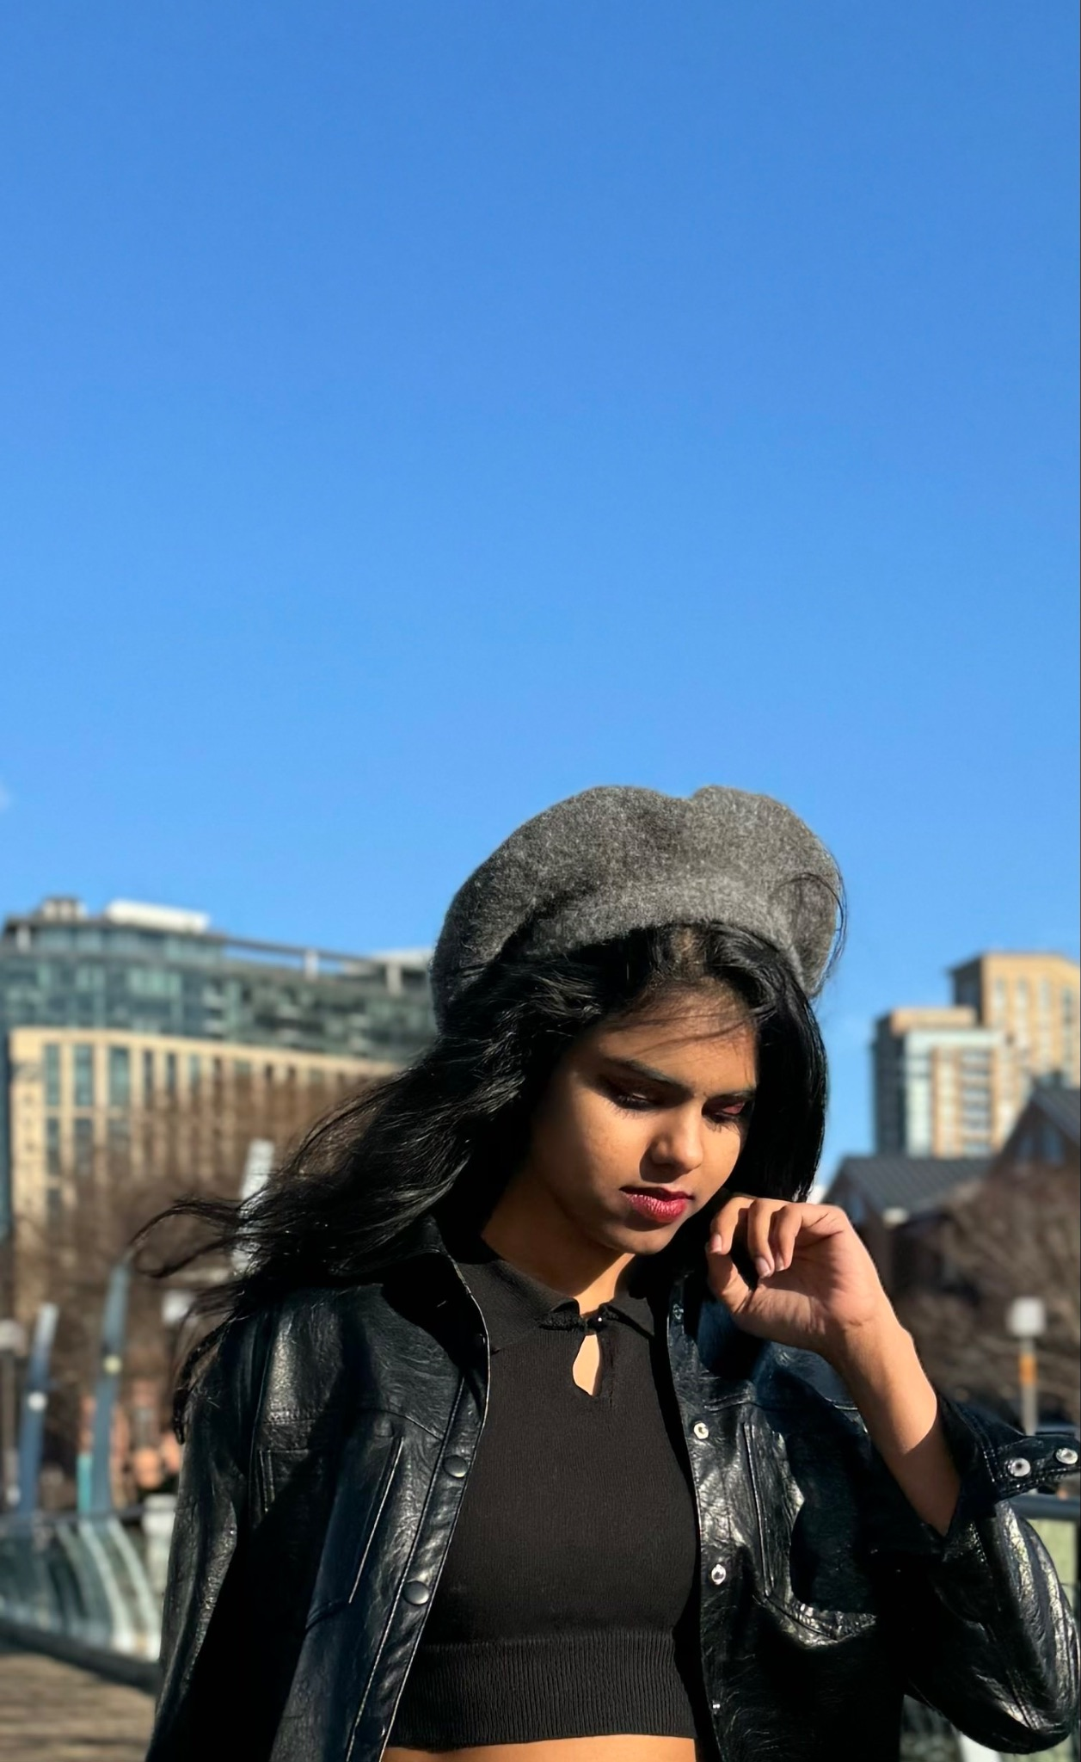
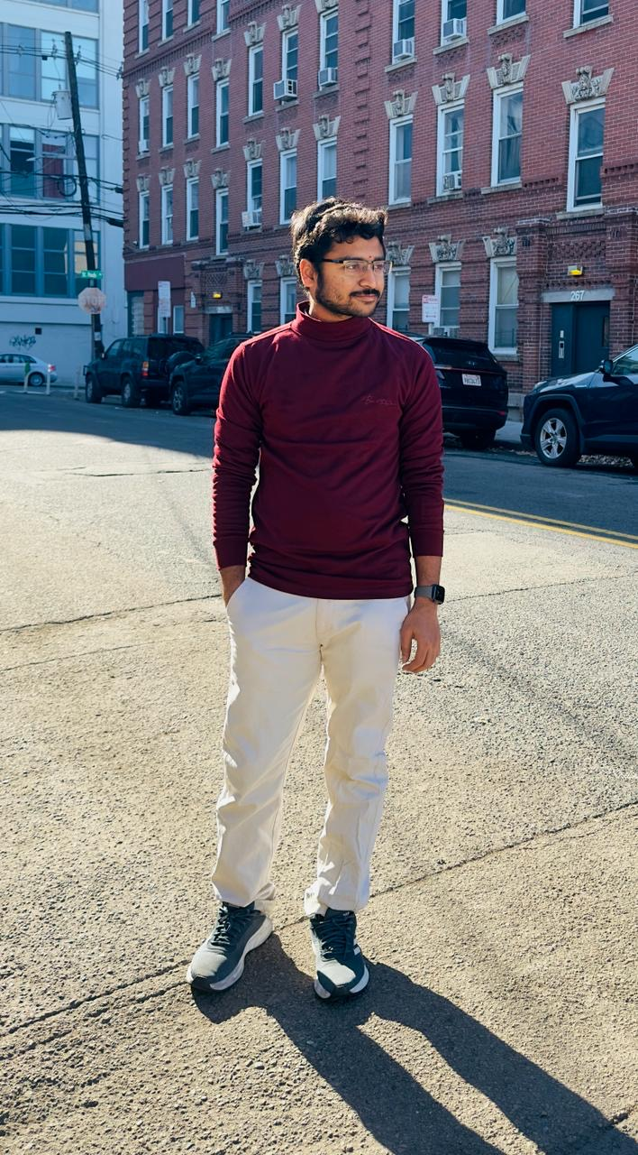
Team members and roles:
Bala Sahithi Kamana
U01874528
Backend Developer
Aditya Gadhave
U01848897
Software Developer
Hemanvitha Mylapalli
U01872551
Frontend Developer
Shashank Akavaram
U01867155
Frontend Developer

Slide 6

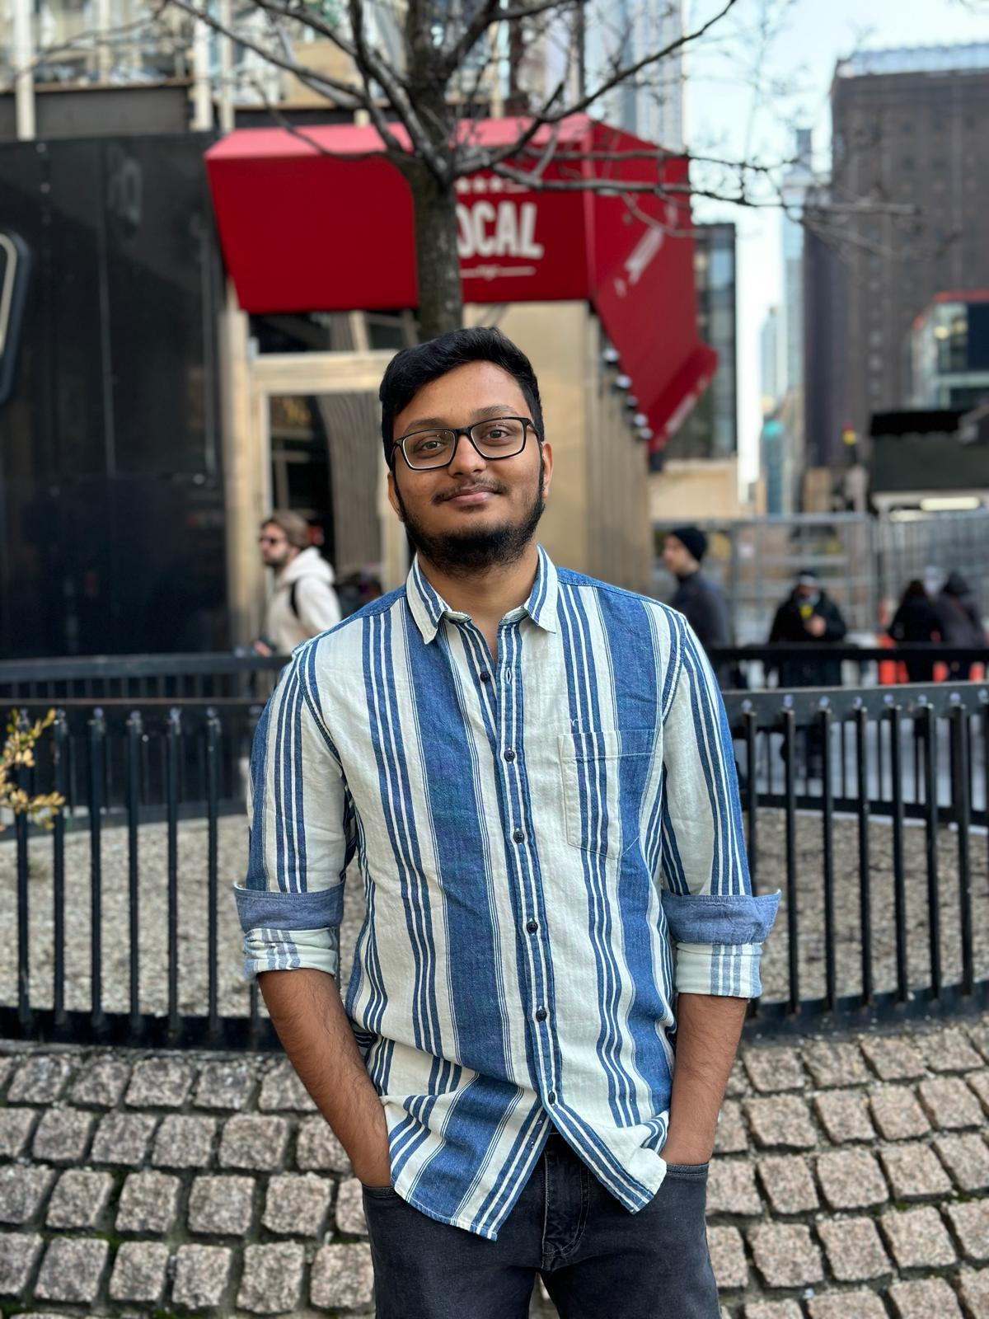

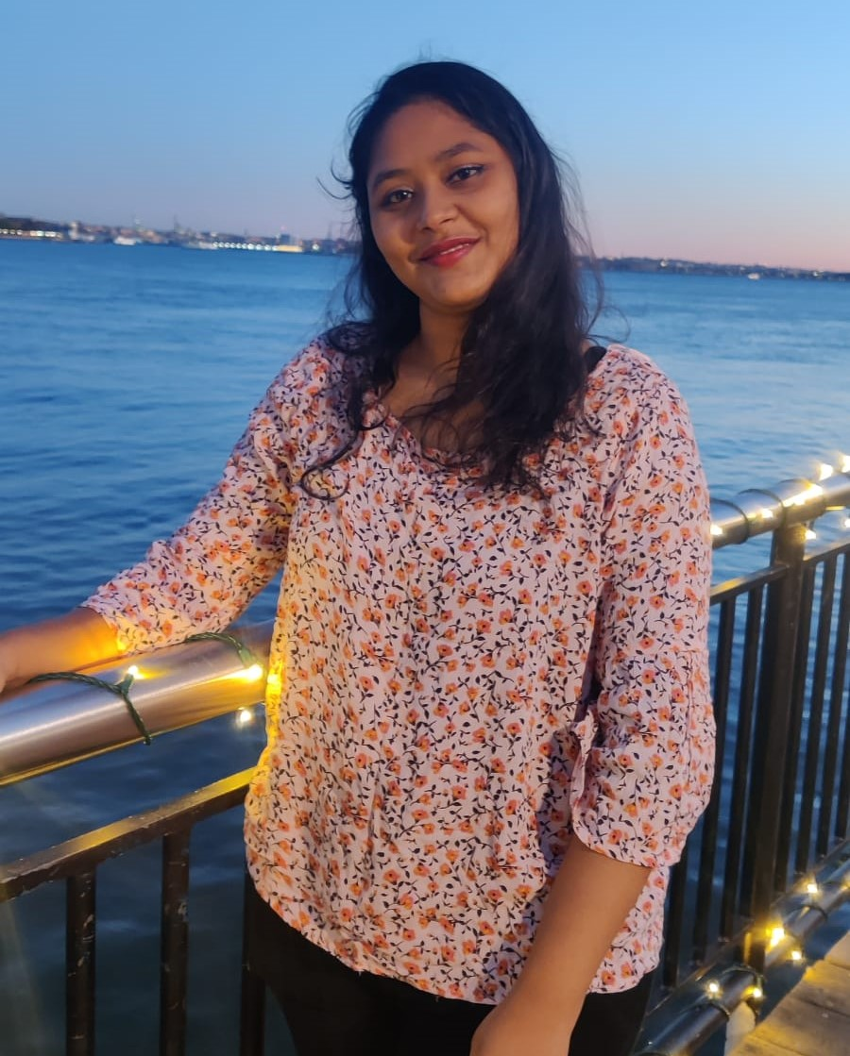
Team members and roles:
Sasank Chaudhary
U01873386
Software Developer
Yuga Kapil Krishna Maytheramatla
U01874012
Backend Developer
Neha Srinivasaiah
U01871437
Software Test Engineer
Sujitha Chethireddy
U01868531
Software Test Engineer

Slide 7
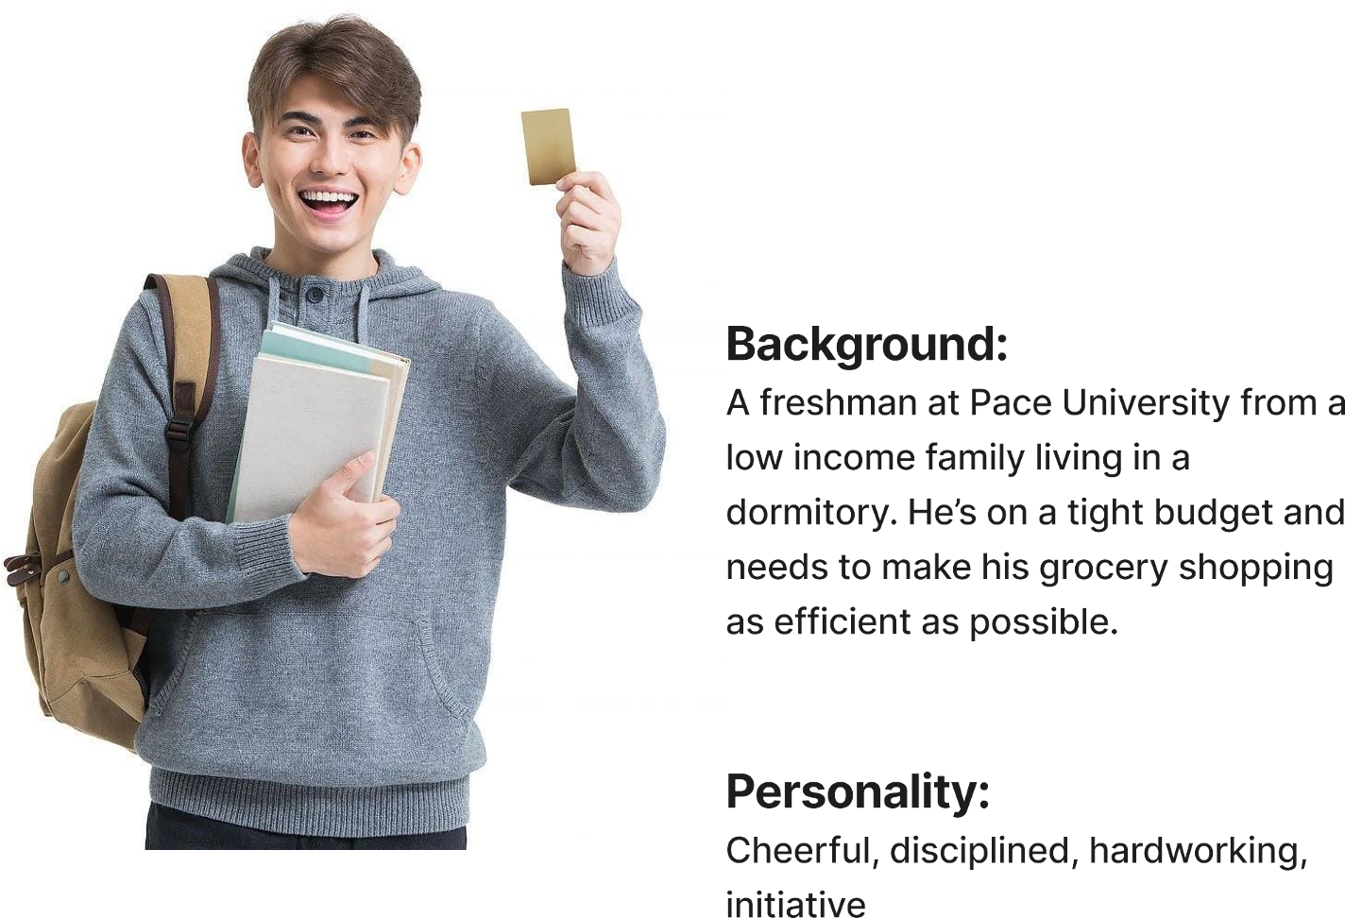
Persona 1:
Cael
21 years old, freshman
Background:
A freshman at Pace University from a low income family living in a dormitory. He’s on a tight budget and needs to make his grocery shopping as efficient as possible.
Personality:
Cheerful, disciplined, hardworking, Initiative
Goals:
Cael aims to save money by
minimizing his food waste and
maintain a healthy diet without
investing excessive time in cooking. He seeks to achieve his goals by utilizing ingredients he already have while ensuring the nutritional value in his meals.

Slide 8
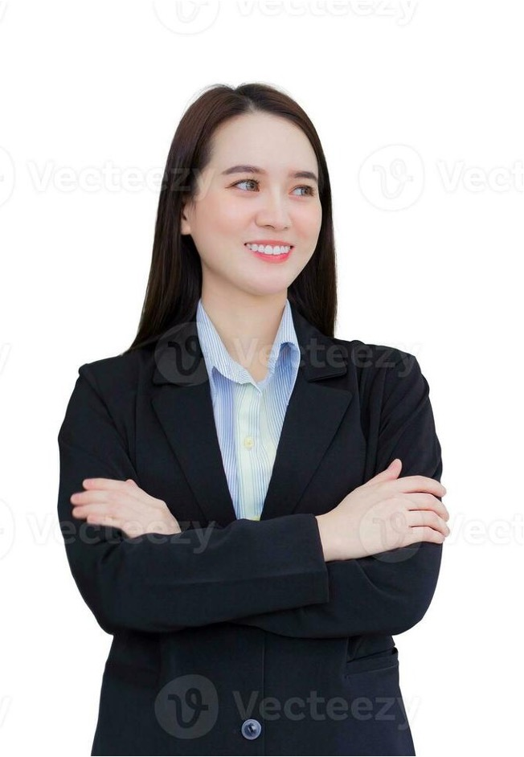
Persona 2:
Zhou
32 years old, Advocate
Background:
Zhou is an advocate who is leading a
busy lifestyle. She is health
conscious and enjoys cooking
nutritious meals at home.
Personality:
Altruistic, organized, passionate,
Perseverance
Goals:
Zhou aims to uphold a nutritious diet and streamline her grocery shopping by focusing on essential ingredients.
She also wants to explore various
recipes that match her dietary
preferences, making her dining
experiences more enjoyable.

Slide 9
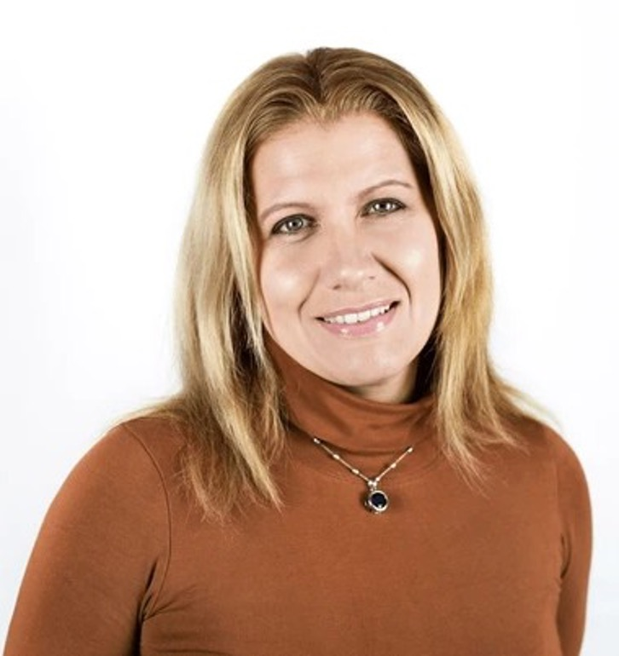
Persona 3:
Michelle
44 years old, Busy Mom
Background:
Michelle is a working mom of four. She juggles between a demanding job and household responsibilities.
Personality:
Empathetic, forgiving, nurturing,
Patience
Goals:
Michelle aims to provide her family
healthy, balanced meals while
reducing food waste. She seeks to
streamline meal planning to save time
and avoid frequent trips to store for
ingredients.

Slide 10
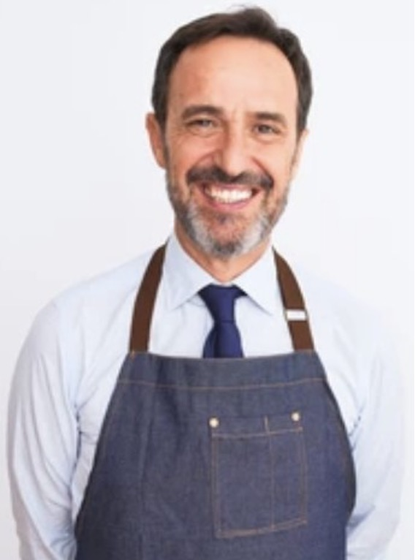
Persona 4:
Diego
49 years old,
Restaurant Manager
Background:
Diego manages a small restaurant specializing in local cuisine. He’s constantly balancing various tasks
and often overlooks inventory
management, leading to occasional food wastage.
Personality:
Creative, Community-Minded,
Entrepreneurial, Passionate
Needs:
Diego desires a system that can
assist him in monitoring the
restaurant’s food inventory, suggest recipes utilizing existing ingredients, and alert him about nearing expiry of food items.
Goals:
Diego aims to reduce food waste,
optimize inventory utilization to
improve profitability and streamline
his inventory management process to focus more on customer service

Slide 11








Technologies and Languages:
Java
HTML
React
JavaScript
MySQL
VisualStudio Code
GitHub
Jira Board

Slide 12
Teamwork Agreement:
The goal of our Teamwork Agreement is to establish expectations for behavior in an attempt to foster collaboration and productivity. The specific roles and responsibilities of each member may vary as the project progresses. Agendas are distributed beforehand by WhatsApp or email. One meeting per week is scheduled for Saturdays, and daily meetings are held for Scrum. Important decisions will be made collectively, documented, and shared with all participants.

Slide 13
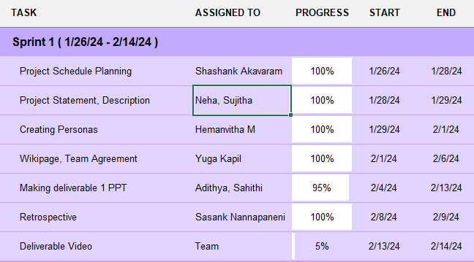
Schedule:

Slide 14
Retrospective- What Worked Well:
Smooth Setup: We successfully handled tasks like setting up the environment and configuring tools.
Ready for Action: We carefully got everything ready for the next sprints. Sprint 1 was a win – we completed all the setup tasks and nailed down our project ideas.
Requirement Story: We documented all the project needs, user details, and agreed on how the team will work together.
Team Harmony: We did a great job working together as a team. Our communication was effective, and we created a really collaborative environment.

Slide 15
What Needs To Be Improved:
Frequency of Team meetings and time to finalize on discussions and tasks.
Need to set up Jira board for task tracking.

Slide 16
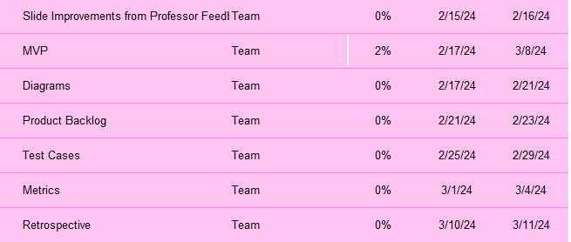
What Next:

Slide 17
Wiki Page
https://github.com/htmw/2024S-neon-nomads/wiki

